Slide 1




DRS and Tax Excise
ITSA Seminar, Santiago

Slide 2

Deposit Return Schemes: an efficient way to combine a tax excise system with the circular economy

Slide 3
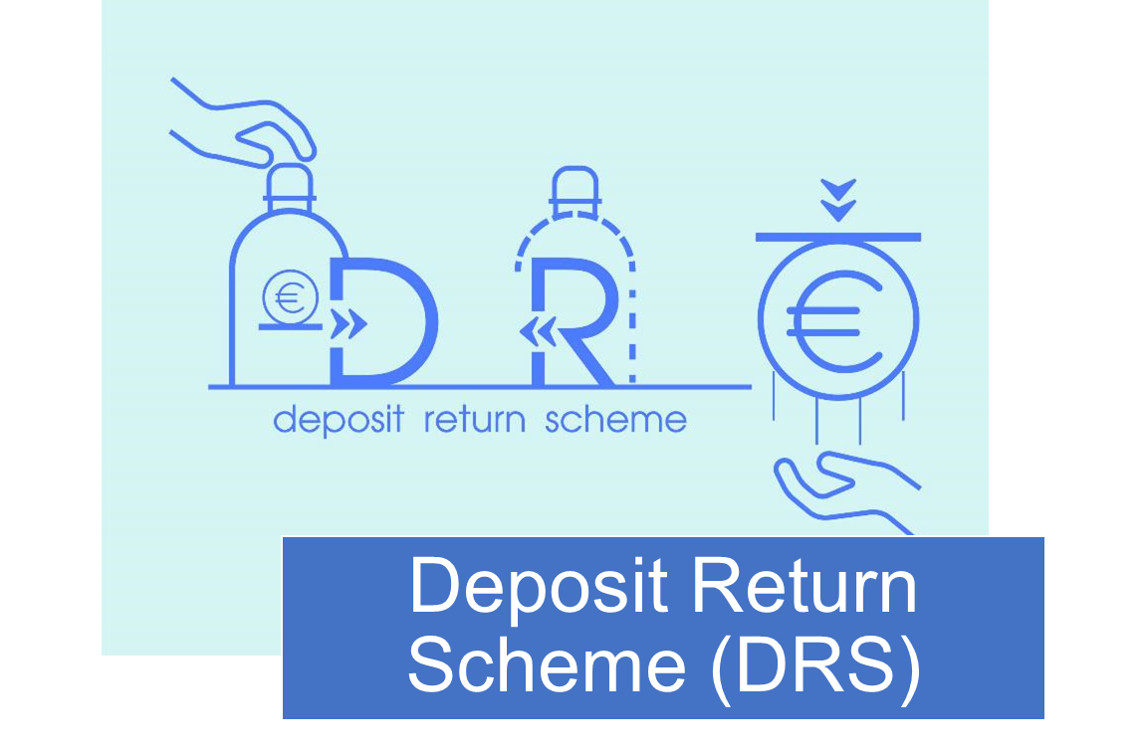
What is a Deposit Return Scheme ?
Drink containers (plastic and glass bottles, aluminum cans) provide one of the most effective recycling opportunities to reach Circular Economy and Climate Change targets towards a Net-Zero Future, with the help of deposit schemes which motivate consumers to return their empty containers
ITSA Seminar / HSP LatAm

Slide 4
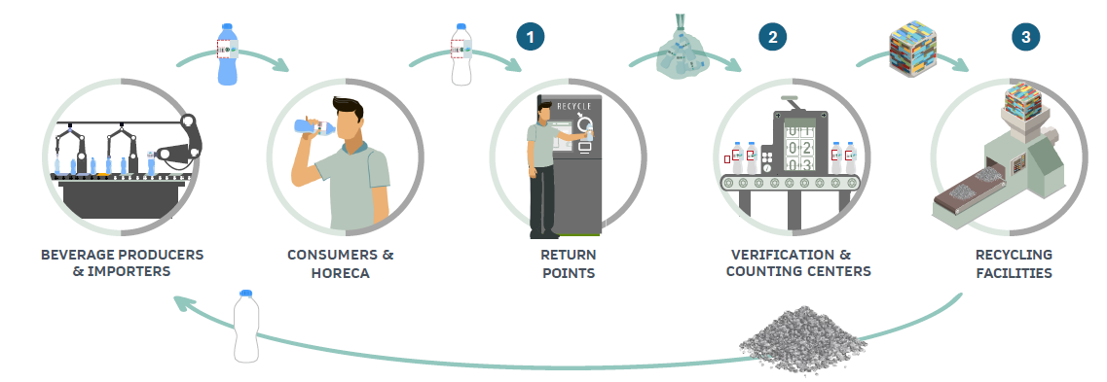
Material Flow
ITSA Seminar / HSP LatAm

Slide 5
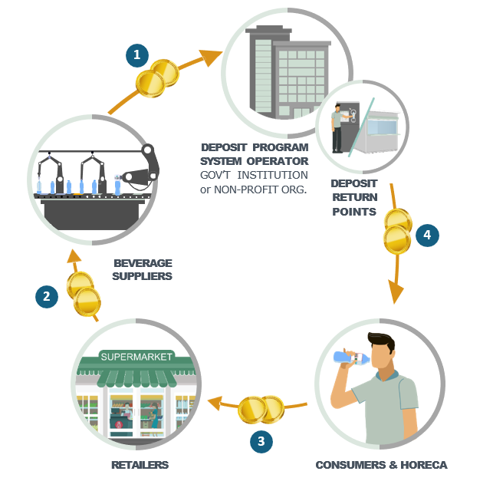
Financial Flow
ITSA Seminar / HSP LatAm

Slide 6
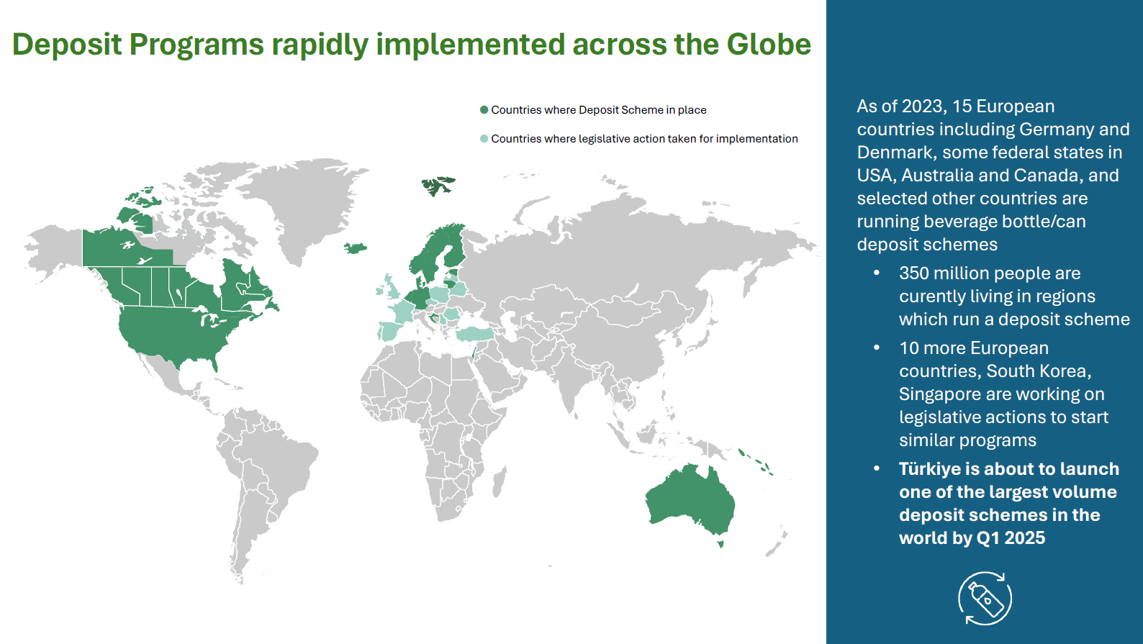

Slide 7
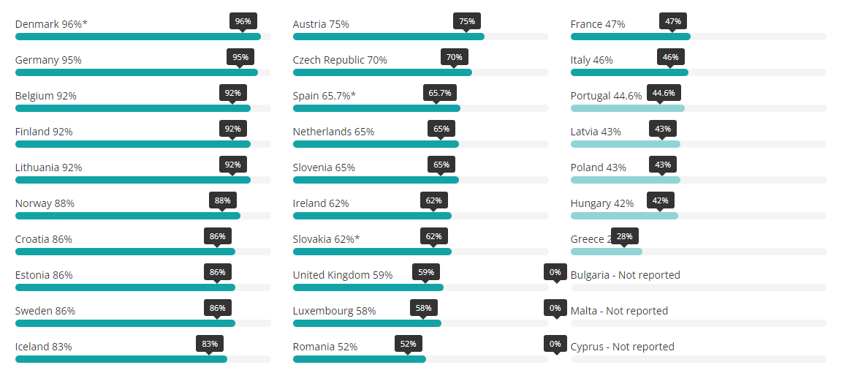
Collection Rates PET bottles in Europe
Source : UNESDA
ITSA Seminar / HSP LatAm

Slide 8
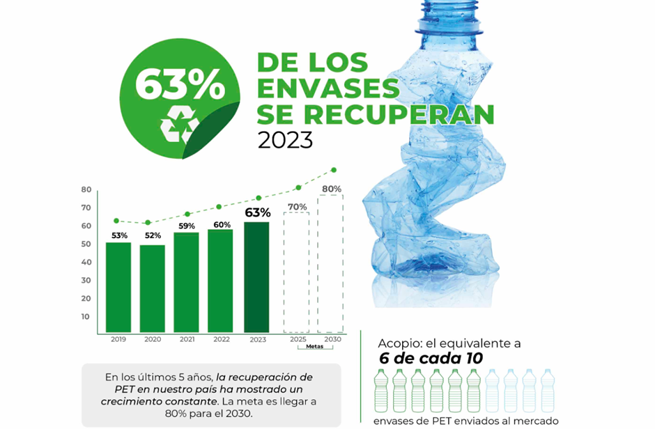
Mexico
Source : ECOCE
ITSA Seminar / HSP LatAm

Slide 9
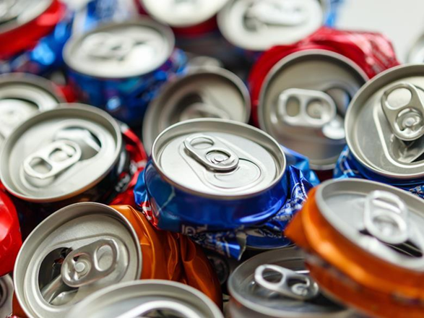
Brazil achieves 100% aluminium can recycling rate
Source : Packaging Europe
ITSA Seminar / HSP LatAm

Slide 10
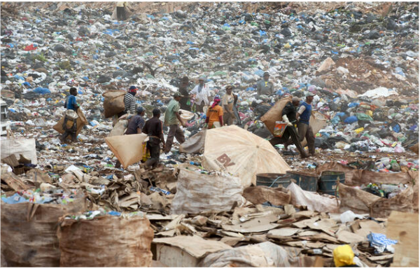

Slide 11

What is EPR ?
Extended Producer Responsibility (EPR) extends the producer’s financial responsibility for a product/packaging to include the management of the post-consumer stage, to help meet national recycling and recovery targets.
EPR policies thus generally shift the waste management cost or physical collection partially or fully from local governments to producers.
ITSA Seminar / HSP LatAm

Slide 12

Chile
EPR introduced
Single use Plastic Regulation
Plastic bottles recycled materials targets:
  2025: 15%
  2030: 25%
  2040: 50%
  2050: 60%
ITSA Seminar / HSP LatAm

Slide 13
State of play on beverage container collection and recycling in LatAm
Large regional differences in recycling rates.
In countries with high collection rates, this is obtained in the informal economy, with little governmental overview.
Targets for recycled content difficult to achieve without higher recycling rates
Authorities missing the opportunity to use the value of the PET and aluminium to improve waste collection and recycling infrastructure.
→ Introduction of a DRS and EPR hands control of the financial value of the used beverage containers to the Authorities, allowing to build a waste collection and recycling industry.
ITSA Seminar / HSP LatAm

Slide 14
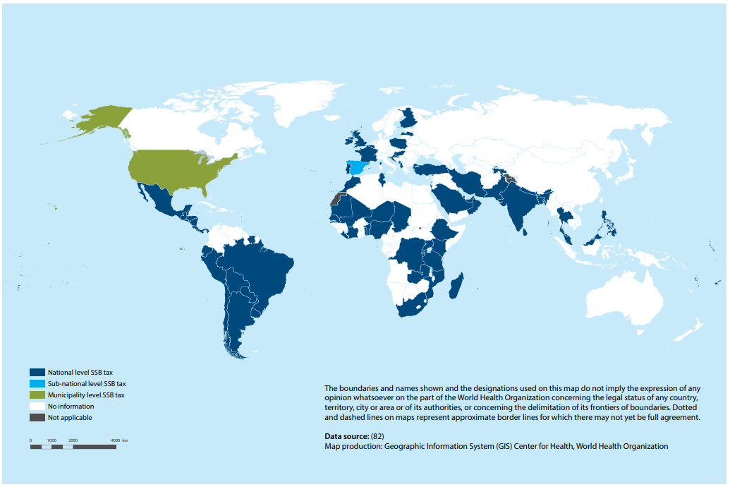
SSB Taxes in Latin America
ITSA Seminar / HSP LatAm

Slide 15
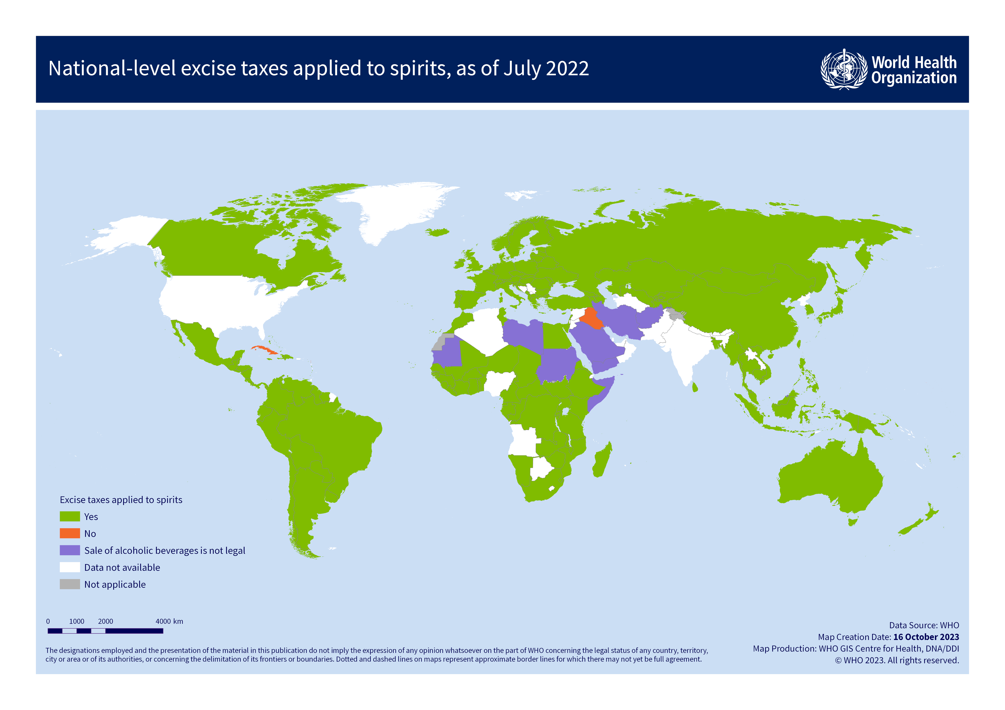
Alcohol Taxes in Latin America
ITSA Seminar / HSP LatAm

Slide 16
State of play of tax levy on beverages in Latin America
Wide adoption throughout the region.
Efficiency depends on the security of the system and the robustness of the enforcement, including the resources available for revenue, border and police authorities.
→ More secure systems will reduce revenue loss for governments.
ITSA Seminar / HSP LatAm

Slide 17
System Integration

Slide 18
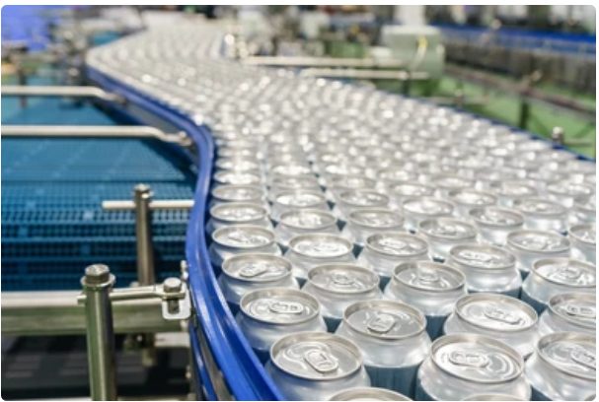
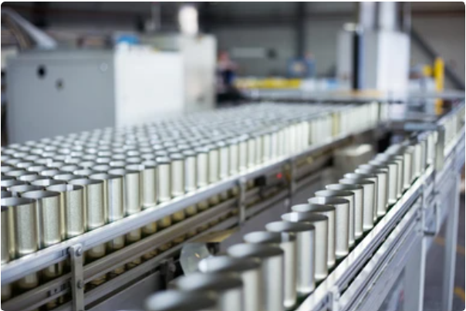
System Integration
Preprint of Secure DRS Mark
Control if Secure DRS Mark is present
Activate Tax Stamp
Apply Tax Stamp or Print Secure DM
Invoice Tax and Deposit Fee
ITSA Seminar / HSP LatAm

Slide 19
Advantages of Implementing DRS/EPR
Environmental Impact
Economic and Social Benefits
Community and Brand Advantages
ITSA Seminar / HSP LatAm

Slide 20

Who Are we?
Luminescence Sun Chemical Security is the global security business unit of Sun Chemical.
Focused on the manufacture of security inks, for all types of secure documents and brand authentication, as well as devices to check security marks and barcodes.
ITSA Seminar / HSP LatAm

Slide 21
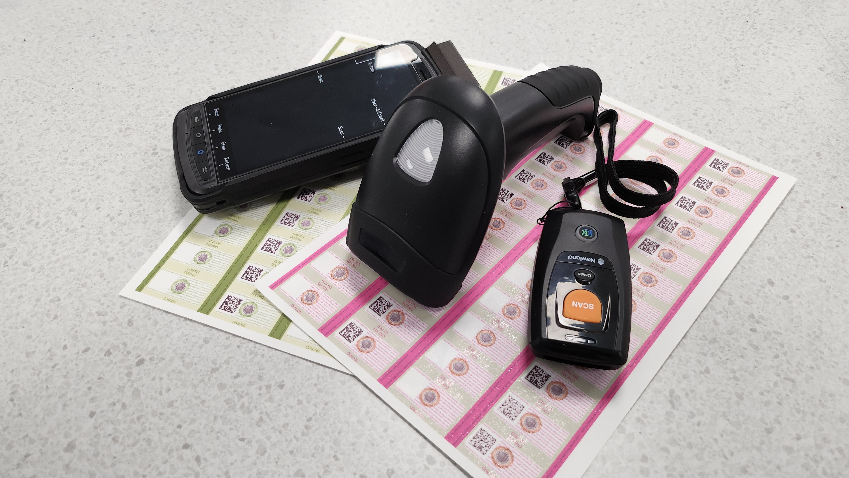

Slide 22
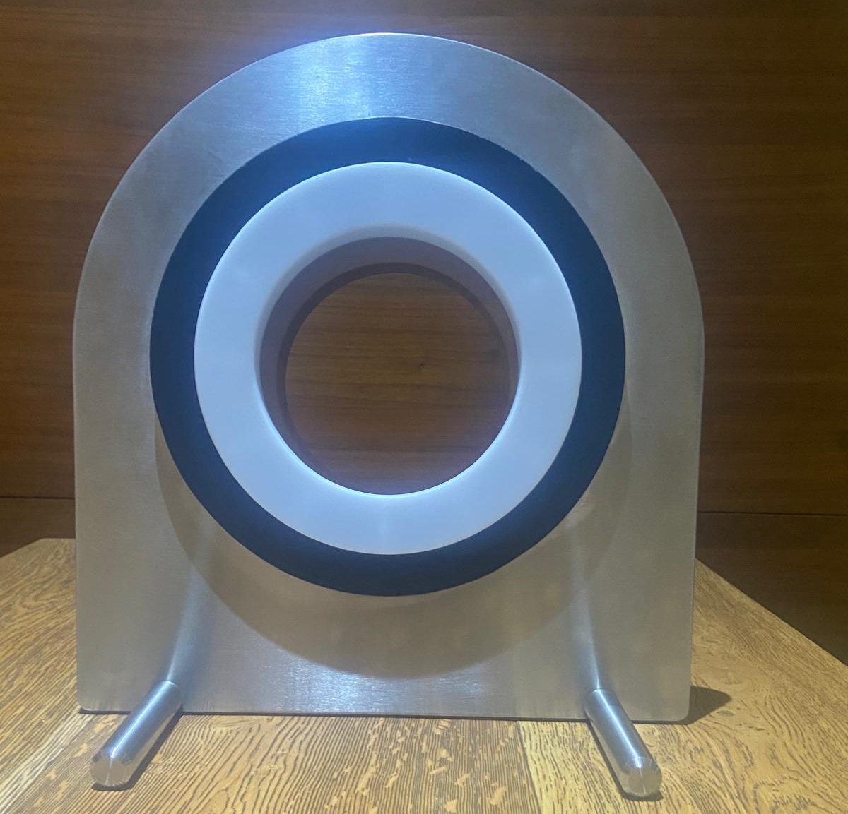
Please visit us at Booth C2
ITSA Seminar / HSP LatAm

