Slide 1

Preparing The Legal & Regulatory Path to Legalized Cannabis Traceability
Spencer Mandy
Vice President
Currency & Excise Control

Slide 2

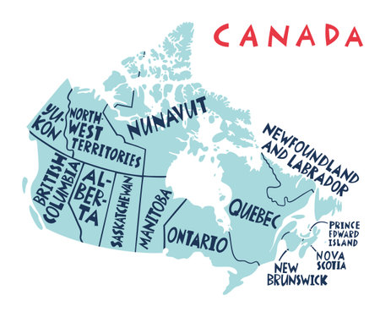
Nation of 40 million people
GDP of over $2.2 Trillion
Second Largest Country in the world by Land Mass
2 million freshwater lakes - 31,000+ are over 3 square kms
We have 6 Time Zones
We share the longest unprotected border in the world with the US
Our coldest temperature ever recorded was -63 Celsius

Slide 3

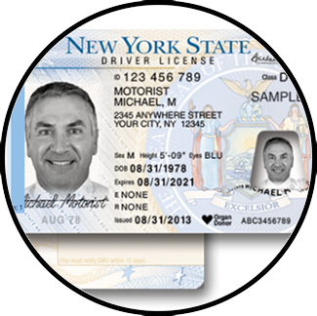
Excise Control
Border Security
Currency
Civil Identity
Lotteries and Gaming
Driver and Vehicle

Slide 4
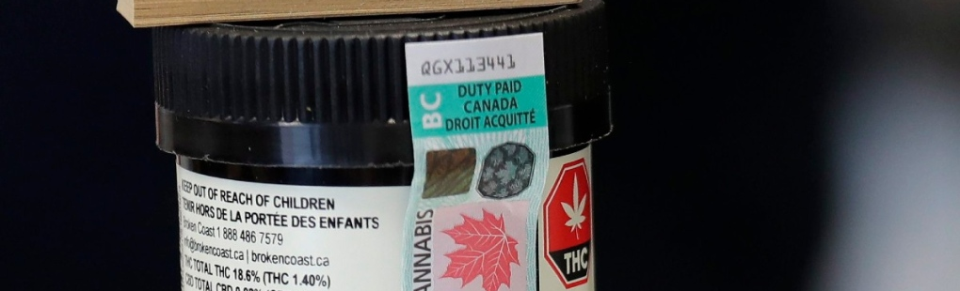
Excise Control
Provider of Canada’s excise control solution since 2007.
Long term agreements with multiple federal government revenue agencies providing full-service excise control solutions
Partner with private sector licensed producers

Slide 5
Overview
Early Days
The Medicinal Legalization
The Trudeau Win
The Task Force on Cannabis Legalization and Regulation
Bill C-45
Implementing Traceability

Slide 6
Early Days
Early Days
Medicinal Legalization
Trudeau Win
Task Force on Cannabis Legalization and Regulation
Bill C-45
Implementing Traceability
Setting the Stage
1938 ~ Cannabis becomes Illegal in Canada
1961 ~ Licensing by Health Canada of Experimental Growers begins
1973 ~ The Le Dain Commission Report
2000 ~ The Ontario Court of Appeal decided that cannabis prohibition was unconstitutional because it did not make an exemption for medical use
2001 ~ Health Canada regulates access to cannabis for licensed patients providing compassionate end-of-life care, helping with nausea and vomiting during chemotherapy treatment, and the alleviation of chronic pain
Notes:
The LeDain Commission was appointed 29 May 1969 and published 4 reports 1970-73.
the commission investigated the role governments and courts should play in prohibiting and regulating the use and distribution of drugs (particularly opiate and marijuana, but also alcohol, barbiturates, amphetamines and others) used for nonmedical purposes.
The final report (1973) contained extensive scientific documentation and recommended that a gradual withdrawal of the use of the criminal law against nonmedical users of cannabis,

Slide 7
Medicinal Legalization
Early Days
Medicinal Legalization
Trudeau Win
Task Force on Cannabis Legalization and Regulation
Bill C-45
Implementing Traceability
Laying Framework for Production
2001 ~ Prairie Plant Systems wins a 5-year contract to supply the Federal Government with medicinal cannabis grown in an abandoned copper mine in Manitoba
2003 ~ Provinces begin processes to reduce penalties and/or decriminalize
2013 ~ New federal regulations allow for the production and distribution of medical cannabis, creating a licensed, commercial industry
2015 ~ Supreme Court allows for the production of medicinal cannabis oils and extracts that can be added to food and drinks
2016 ~ 70,000 Canadians are registered as medicinal cannabis users. Card-carrying users can grow marijuana for their own medical use or order it from one of 116 licensed producers and have medicinal cannabis mailed to them.

Slide 8
Early Days
Medicinal Legalization
Trudeau Win
Task Force on Cannabis Legalization and Regulation
Bill C-45
Implementing Traceability
The Trudeau Win
Politics, Public Opinion and The Polls
2013 ~ As Canada prepares for an election, Justin Trudeau plants a seed:
“I’m in favor of legalizing it. Tax it, regulate it. It’s one of the only ways to keep it out of the hands of our kids, because the current war on drugs, the current model is not working.”
2015 ~ Trudeau leads the Liberal Party from third place to win a majority government, defeating incumbent Prime Minister Stephen Harper and the Conservative Party

Slide 9
Early Days
Medicinal Legalization
Trudeau Win
Task Force on Cannabis Legalization and Regulation
Bill C-45
Implementing Traceability
The Task Force on Cannabis Legalization and Regulation
Real Work Starts on Recreational Cannabis Legalization
Trudeau creates the Task Force on Cannabis Legalisation and Regulation in June of 2016
The Task Force undertook extensive consultations with:
Experts
Patients and advocates
Employers and industry
Provinces, territories, and municipalities
Indigenous governments and representative organizations
Veteran’s Advocacy groups
Notes:
Trudeau creates the Task Force on Cannabis Legalisation and Regulation in June of 2016
Nine Members
Experts in Policy, Civic Politics, Medicine, Enforcement

Slide 10
Early Days
Medicinal Legalization
Trudeau Win
Task Force on Cannabis Legalization and Regulation
Bill C-45
Implementing Traceability
Bill C-45 ~ The Cannabis Act
The Result
In April of 2017 Canada introduced Bill C-45 – THE CANNABIS ACT with the overarching mission to:
Protect the health and safety of Canadians
Keep cannabis out of the hands of children and youth
Keep profits out of the hands of criminals and organized crime
Bill C-45 received Royal Assent in June of 2018
The Cannabis Act and its regulations came into force October 17th, 2018

Slide 11
Bill C-45 ~ The Cannabis Act
“One of the things we have learned, from states like Washington and Colorado is take your time because it’s much harder to pull something back than it is to perhaps be a little bit more restrictive out of the box and then, as you learn, you maybe loosen things up a bit,”
- Task Force Chair, Anne McLellan
Early Days
Medicinal Legalization
Trudeau Win
Task Force on Cannabis Legalization and Regulation
Bill C-45
Implementing Traceability
First Steps in Regulation
Initially the Cannabis Act addressed areas including:
Set Federal minimum age requirement at 18
Prohibiting products that are appealing to youth
Legal sales were only permitted for certain products
  Dried Cannabis, Fresh Cannabis, Cannabis Oil, Cannabis Plants and Seeds
Setting out strict guidelines for packaging or labelling
Strict regulations on Promotion and Marketing
Strict standardization on serving sizes and potency
Laid out industry wide standards for production and cultivation
Set personal possession limits (30 grams)
Set limits for at home growth (4 plants per household)

Slide 12
Bill C-45 ~ The Cannabis Act
Early Days
Medicinal Legalization
Trudeau Win
Task Force on Cannabis Legalization and Regulation
Bill C-45
Implementing Traceability
Language Shift Between Criminal Code to Act & Regulation
Criminal Code
Illegal Production
Illicit Sale
Possession of Any Kind
Drug Trade
Smuggling
Surveillance
Seizure
Trafficking
Summary Offenses
Convictions
Act & Regulation
Licencing
Taxation
Possession & Growing Limits
Regulated Exportation
Diversion
Tracking
Inspection
Promotion
Administrative Monetary Penalties
Pardons

Slide 13

Implementing Traceability
Early Days
Medicinal Legalization
Trudeau Win
The Task Force on Cannabis Legalization and Regulation
Bill C-45
Implementing Traceability
Mandatory Elements of The Program
Educate & Protect the General Public
Support Government Health Directives
Combat Diversion
Combat Illicit Production
Generate and Protect Revenues

Slide 14
Implementing Traceability
Early Days
Medicinal Legalization
Trudeau Win
The Task Force on Cannabis Legalization and Regulation
Bill C-45
Implementing Traceability
How to achieve those Elements?
Introduce an Excise Stamp that the general public can easily identify on product
Support public education campaigns
Expand it’s use to cover tamper proofing
The stamp represents a promise that product is safe
Educate & Protect the General Public
Support Government Health Directives
Make Health Authority approval the only avenue to access to Excise Stamps
  Product Potency Controls
  Production Standards
  Approved Product Classifications

Slide 15
Implementing Traceability
Early Days
Medicinal Legalization
Trudeau Win
The Task Force on Cannabis Legalization and Regulation
Bill C-45
Implementing Traceability
How to achieve those Elements?
Only approved licenced producers have access to stamps
Absence of stamp easily points to illegal product
Stamps are individually assigned to specific licenced producers
Combat Illicit Production
Combat Diversion
Approved stamp ordering limits are based on client provided business plans / product size specs and growing capacity
Only stamped product can be sold
Everything has to reconcile
Frequent audits – on site / in field / remote

Slide 16
Implementing Traceability
Early Days
Medicinal Legalization
Trudeau Win
The Task Force on Cannabis Legalization and Regulation
Bill C-45
Implementing Traceability
How to achieve those Elements?
Stamps represent Govt Revenue
Monthly Reporting based on stamp ordering vs. consumption reconciliation
Mandate application / consumption point for stamps (smallest form of sellable product)
Utilized Excise Control System Reconciliation Module to streamline reporting
Reporting employs calculations prescribed through published tax tables
Absence of payment cuts off stamp supply and triggers investigation
Effective form of brand protection for licenced producers
Generate and Protect Revenues

Slide 17
Implementing Traceability
Early Days
Medicinal Legalization
Trudeau Win
The Task Force on Cannabis Legalization and Regulation
Bill C-45
Implementing Traceability
Requires Coordination Across Departments and Governments
Federal Government
HEALTH CANADA
Licensing
CANADA REVENUE AGENCY
Excise Stamp Program Enforcement Revenue Collection
Provincial Government
Sales Distribution
E n f o r c e m e n t

Slide 18
Early Days
Medicinal Legalization
Trudeau Win
The Task Force on Cannabis Legalization and Regulation
Bill C-45
Implementing Traceability
So, How is it going?

Slide 19
The Lessons
Early Days
Medicinal Legalization
Trudeau Win
The Task Force on Cannabis Legalization and Regulation
Bill C-45
Implementing Traceability
Lack of Medicinal Prioritization
Over issuance of Licensing
Over production
Distribution
Consumer Demand
Blindspots in Legislation allowing for continued Black Market porduction
Enforcement
Notes:
Distrubtuion- Each province has retained the autonomy to determine how cannabis is bought and sold within its borders, resulting in a patchwork of policies that are subject to frequent change, as well as structural inefficiencies that have added unnecessary complexities to the industry.

Slide 20
The Good !
Early Days
Medicinal Legalization
Trudeau Win
The Task Force on Cannabis Legalization and Regulation
Bill C-45
Implementing Traceability
70% of Cannabis consumed in Canada is legal
Contributed $54 billion to Canada’s GDP
Led to the creation of 151,000 jobs
Generated approx. $10 billion in tax revenues
$4.7 billion in Sales of Recreational Cannabis through Authorized Retail Outlets in 2023 alone.

Slide 21
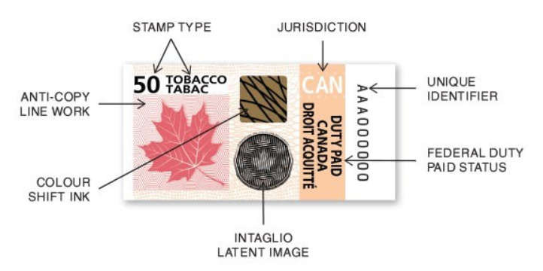
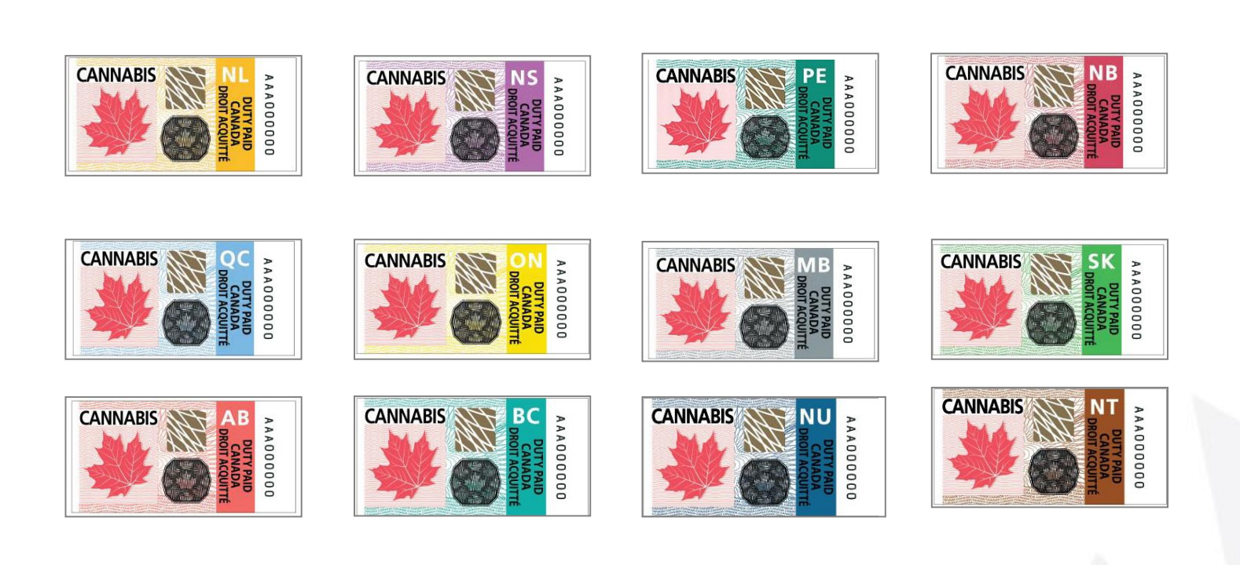
Early Days
Medicinal Legalization
Trudeau Win
The Task Force on Cannabis Legalization and Regulation
Bill C-45
Implementing Traceability
Bank Note Grade Security Stamp Design

