Slide 1
TAX STAMPS AND TRACK AND TRACE:
THE IMPORTANCE OF PROPER ANALYSES – BEFORE AND AFTER IMPLEMENTATION
Notes:
Now that an increasing number of countries are moving towards implementing track and trace systems, especially on tobacco and alcohol products, and especially in response to WHO FCTC Protocol requirements, this presentation describes a case where ITSA was asked to evaluate a study compiled by the Costa Rica Ministry of Finance on the cost versus benefit of implementing track and trace on alcohol.
ITSA’s evaluation illustrates how important it is use accurate information based on thorough research acquired through qualified sources, in order to make informed decisions with regard to implementation.
That’s the ’Before’ bit of the title of this presentation.
The ‘After’ bit refers to the importance, in the months and years following implementation, to conduct analyses into the effect of the system on tax revenues and illicit trade levels. To illustrate this, we’ll use a recent analysis published by economics academics in Chile as an example.

Slide 2
COSTA RICA’S FINDINGS
Based on $0.10-$0.14 per tax stamp including logistics
To obtain any benefit, must recover almost all illegal alcohol – unrealistic
High cost compared to benefit
Some countries initially good results but no consistent improvement
Notes:
Data for the Costa Rica study (available at www.hacienda.go.cr/docs/EstudioTrazabilidadLicoresLey9961.pdf) was compiled from sources within Costa Rica Customs as well as ‘national and international corporations offering traceability systems’.
The costs used in the study were provided by ‘several private companies’ and estimated to be between $0.10-0.14 per tax stamp, including logistics costs.
The study concluded that while it is true that some countries initially show favourable results from implementing such systems, in the medium term, the systems generate very high costs for the industry and do not show consistent improvements over time in terms of revenue collection.

Slide 3
ITSA’S RESPONSE
Most tax stamp costs usually under $0.05 per stamp
Follow Tobacco Protocol – industry to bear costs
With just 20% increase in tax collection cost/benefit = 1/7.5
Evidence belies claim other countries dropping systems
Logistics to apply stamp already in place for other labels – don’t replicate costs!
Notes:
ITSA’s response:
$0.10-0.14 per tax stamp appears to be assumption based on limited research as most tax stamps usually cost under $0.05, including stamp itself plus coding and camera equipment, stamp application equipment, central database management system and field inspection devices.
With just 20% increase in tax collection, cost-benefit ratio would be 1 to 7.5, based on more realistic tax stamp system costs.
For Costa Rica, infrastructure to apply stamps already exists and should not be replicated, given that specific labels already required on each product.
Countries where tax stamps have been successful follow recommendations of WHO Protocol stating ‘each party may require the tobacco industry to bear any costs associated with that party’s obligations under this Article’. Logical step therefore for Costa Rica (as party to Protocol) to transfer same recommendations to alcohol, instead of shouldering cost of system using public finances.
Implementation costs in study also fail to consider documented experience from countries that are seeing tax stamp and traceability system not only as solution to tax evasion, but also to reduce public health costs.

Slide 4

CHILE
Since 2019 – tax stamps, traceability tobacco products, focus on domestic tax evasion and smuggling
Domestic packs – direct secure 2D code applied on production line. SII informed in real-time of number marked
Imports – paper-based tax stamp
Direct code security ink with covert and forensic elements. Tax stamp carries overt, covert, forensic elements + unique identifier
Notes:
In Chile, each cigarette pack is marked with a unique and secure code, directly at tobacco production factory, prior to distribution, and the amount of cigarettes marked is informed in real time to the Servicio de Impuestos Internos (SII) as soon as marking is done. Previously, the quantity of cigarettes and brands produced and commercialised were informed directly by the producer, allowing little opportunity for tax authority to verify exactitude of numbers reported and to reconcile with taxes paid.
Although the stamps are referred to as ‘tax’ stamps, they do not serve as tax payment tools, but rather as tools for track and trace only. The respective excise tax is instead declared and paid by means of regular lodgement processes.

Slide 5
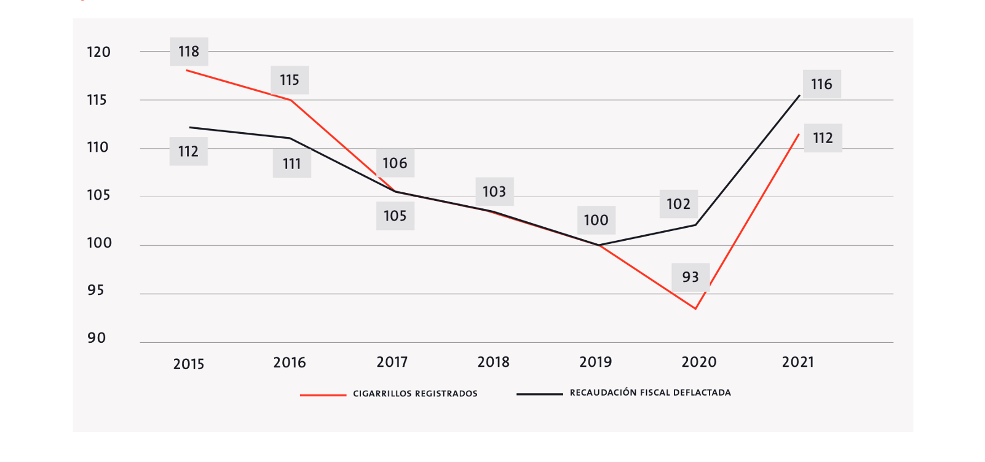
CHILE TOBACCO TAX REVENUES
Notes:
The latest information from Chile comes from a study by economists at Business School Universidad Adolfo Ibáñez Chile, published April 2023 in www.tabaconomia.uai.cl. Private university in Latin America as partner of Bloomberg Philanthropies’ initiative to reduce tobacco consumption. As of publishing date, Chilean government not released information on the effect of track and trace on revenues or illicit trade.
Using 2019 = 100 as base, graph shows evolution of tax revenues on cigarettes (black line) vs. number of cigarettes produced that were registered as tax-paying (red line). In 2020 and 2021, real tax collection increased despite lower amount of cigarettes sold.
The 2020 increase is significant, as despite reduction in production of cigarettes paying taxes, it implies sharp increase in cigarette prices, which could explain the increase in revenue, as the ad-valorem component of the cigarette tax depends on quantity and price.
Another insight from graph is a marked growth in cigarettes that effectively paid taxes in 2021. Since tobacco usage relatively constant 2020-2022, growth therefore points to less illicit trade.
Also Chile’s tobacco exports, which are exempt from all taxes levied on tobacco in-country, became visibly differentiated from those produced for internal consumption (now marked), making illegal re-entry of cigarettes destined for external sale more complex, something that was quite easy prior to track and trace.
Furthermore, cigarette exports from Chile fell by 10% between 2019-2020, and by 38% between 2020-2021, when track and trace was in full force.

Slide 6
CONCLUSIONS CHILE STUDY
If higher 2021 production due to better controls then pre-T&T reporting inadequate
+16% collection 2019-21 due to accurate real-time data
Lower exports due to unique marking domestic product – illicit re-entry harder
Notes:
The study concludes:
Real tax revenue from tobacco taxes increased by 16 percentage points between 2019-2021, attributed, at least initially, to the track and trace system’s accurate reporting of data that made certain manufacturers report real total production. Higher collection ad-valorem component indicates accurate control over mix of brands/prices produced and sold domestically.
If the 2021 increased production for domestic market was due to better control by tax authority of industry numbers, this indicates that, pre-track and trace, the industry did not adequately report value of domestic/export production.
Drop in exports could also be due to unique marking of cigarettes for domestic market, making illicit re-entry more difficult. Pre-track and trace, demand for well-known brands could have been satisfied with cigarettes produced domestically, under-declared to authorities, exported and re-entered illicitly for sale to avoid tax. As mentioned, with track and trace, the number of cigarettes produced is informed to tax authority in real-time during production.
The study concludes that the system indeed increased fiscal control over tobacco industry in Chile, which should encourage implementation of a similar system for alcohol.

Slide 7
SIMULATION MODEL SOUTH AFRICA
Objective T&T ROI analysis specific to jurisdiction
Assumed T&T 60% effective – conservative
Simulation model on T&T cost per pack for governments to recover all costs of T&T
Min breakeven T&T marker cost $0.17 per pack – many times higher than existing systems – eg. Kenya $0.023
Premise – T&T incurs costs but also generates revenue
Applied to South Africa – but adaptable to other countries
Even 4.5% effectiveness generates net additional revenue
Notes:
In another study illustrating the cost/benefit of track and trace on tobacco products, released in 2022, the Research Unit on Economics of Excisable Products (REEP), based at University of Cape Town, created a simulation model for determining what the track and trace cost per pack needed to be for the South African government to recover all costs associated with that system.
Premise of model was that while track and trace systems incur costs for implementation, they also generate additional revenue by diverting illicit cigarettes into legal market. So, there will be a track and trace price at which cost of track and trace equals additional revenue generated. This is the breakeven cost.
Data used for model: government budget data, Euromonitor and retail data, academic studies on size of illegal market.
Model assumed track and trace 60% effective, which is considered a conservative assumption for South Africa, where most illicit products are made in-country by legal entities.
Even effectiveness as little as 4.5% would still generate net additional revenue for the government, assuming marker cost of $0.023 (the cost in Kenya) and no change in retail prices, advised REEP.
The study is available at https://tobaccocontrol.bmj.com/content/tobaccocontrol/early/2022/09/14/tc-2022-057550.full.pdf.

Slide 8
ANALYSIS RECOMMENDATIONS
Objective analysts
Reliable data sources
Tailored to specific jurisdiction

