Slide 1
SECURING THE FUTURE: WHY PHYSICAL FEATURES MATTER IN THE DIGITAL AGE
Notes:
This seminar will address the need for a unified approach to tax stamp and traceability systems that embraces both physical security features and digital technologies. In this digital age, it could be tempting to consider digital-only solutions that may seem easier to implement, but there are risks attached to these solutions.
The seminar will describe what a digital-only system could typically consist of, and what type of fraudulent schemes could thrive, undetected, under such a system. It will then go on to present use cases that have combined physical and digital technologies to positive effect, in terms of increased revenues and taxpayer compliance.

Slide 2
AGENDA
TIME | TITLE | PRESENTER
11.00-11.10 | Welcome and introduction to ITSA | Nicola Sudan, ITSA
11.10-11.25 | What does a digital-only system look like? What are the upsides and downsides? | Ruggero Milanese, SICPA
11.25-11.40 | Why physical features matter in the digital age | Tim McIntyre, Canadian Bank Note
11.40-11.55 | Use case success stories | Tim McIntyre and Ruggero Milanese
11.55-12.10 | Infrastructure and security considerations for blended digital marking programme | Sacha Dover, Crane Authentication
12.10-12.25 | A diligent approach to digital and physical layered technology | Kay Johnston and Tim Long, De La Rue
12.25-12.40 | Innovation in tax stamps: physical and digital aspects | Marietta Ulrich-Horn, Securikett

Slide 3

28 MEMBERS

Slide 4

ITSA’S BROADER MISSION – BEYOND TAX STAMPS
Advocate for physical/digital secure solutions across entire jurisdictions and product categories, which protect products from non-compliance and extend to other functions such as sustainability
Advocate against non-secure digital programmes and programmes not independent from taxpaying entity, like tobacco manufacturers

Slide 5
WHAT DOES DIGITAL-ONLY LOOK LIKE?
Notes:
What does a digital-only system for tax stamps and traceability look like and what are the upsides and downsides of using such a system?

Slide 6
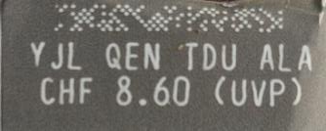
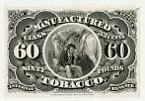
FISCAL MARKINGS / TAX STAMPS
PHYSICAL-ONLY
DIGITAL-ONLY
Authentication
Traceability

Slide 7

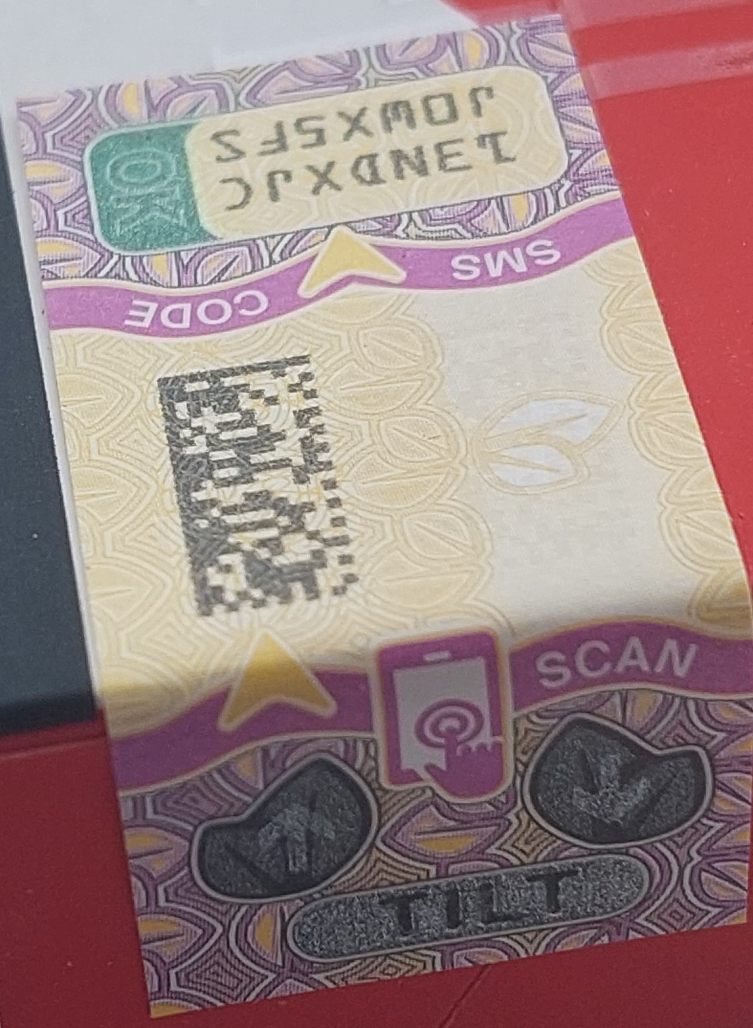
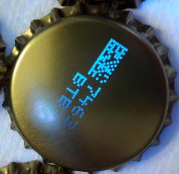
FISCAL MARKINGS / TAX STAMPS
PHYSICAL + DIGITAL Enhanced Tax Stamp
Authentication
Covert
Semi-covert
Overt
Traceability
Unique ID
Machine-readable
Human-readable

Slide 8
DIGITAL ONLY – DESIGN ELEMENTS
 | OPTIONS
UID structure | GS1 (serialised GTIN) | ISO 15459 (unique pre/post-fix) | Proprietary |  |  | Encrypted / digitally signed
Machine-readable symbology | Data Matrix |  | Dot-code
UID generation | Industry | Provider contracted by Industry |  |  | Provider contracted by government | Provider contracted by government
Activation / reporting tech | File upload | Standard API (EPCIS) |  |  | Proprietary API
Activation / reporting party | Provider contracted by the Authority |  |  | Industry / Provider contracted by the Industry

Slide 9

DIGITAL ONLY – FCTC-COMPLIANT?
 | OPTIONS
UID structure | GS1 (serialized GTIN) | ISO 15459 (unique pre/post-fix) | Proprietary |  |  | Encrypted / digitally signed
Machine-readable symbology | Data Matrix |  | Dot-code
UID generation | Industry | Provider contracted by Industry |  |  | Provider contracted by government | Provider contracted by government
Activation / reporting tech | File upload | Standard API (EPCIS) |  |  | Proprietary API
Activation / reporting party | Provider contracted by the Authority |  |  | Industry / Provider contracted by the Industry
Obligations assigned to a Party shall not be performed by or delegated to the tobacco industry.
Interact with the tobacco industry and those representing their interests of the tobacco industry only to the extent strictly necessary

Slide 10
DIGITAL ONLY – MYTHS …. and reality
Consumers can verify the duty-paid status of a product by checking the presence of the code
Presence of DMX inconspicuous / not meaningful to the consumer
Inspectors can detect illicit products through code verification
Finding fraudulent products through codes requires 600 more verifications than are required with stamps (link)
Lower cost
Hidden costs transferred to the industry
Fast to implement
Takes years for all economic operators to equip themselves with the required software & hardware
Less intrusive, higher speed
For tobacco products, most packaging lines are already equipped with stamp applicators
More “modern”
Codentify was invented 20 years ago
Easy to track & trace product in the downstream supply chain
Huge impact on supply chain operators + difficulty to achieve compliance (garbage-in / garbage-out)
Easy to find source of an illicit product
Most illicit products are unlikely to be marked / reported

Slide 11


Slide 12
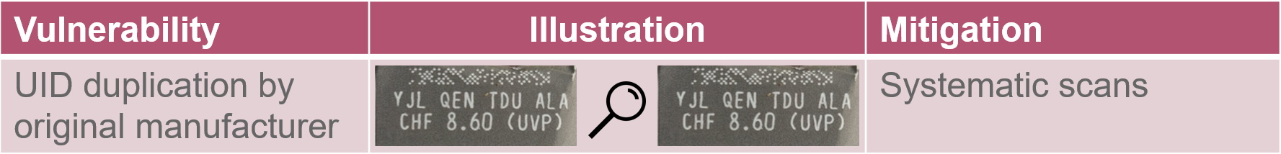
DIGITAL ONLY – KEY VULNERABILITIES

Slide 13
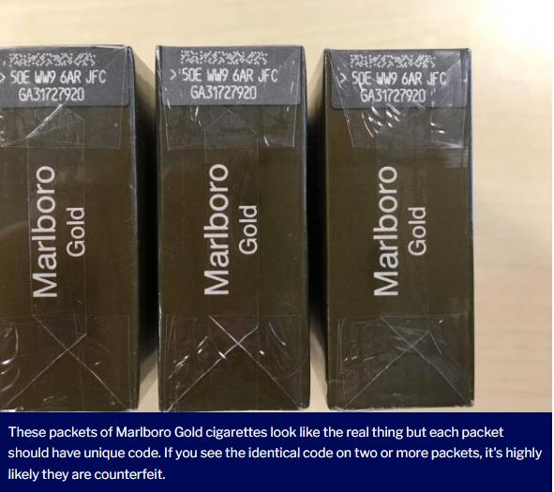

CONCRETE EXAMPLE OF UID DUPLICATION
“We can all play a part in spotting and reporting counterfeit cigarettes”.
Really?
Counterfeit or original?
Source: https://www.oxfordmail.co.uk/news/17423983.fake-cigarettes-oxford-tell-real/

Slide 14


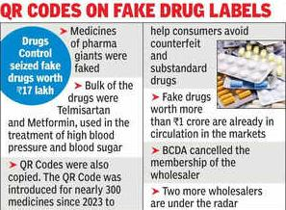
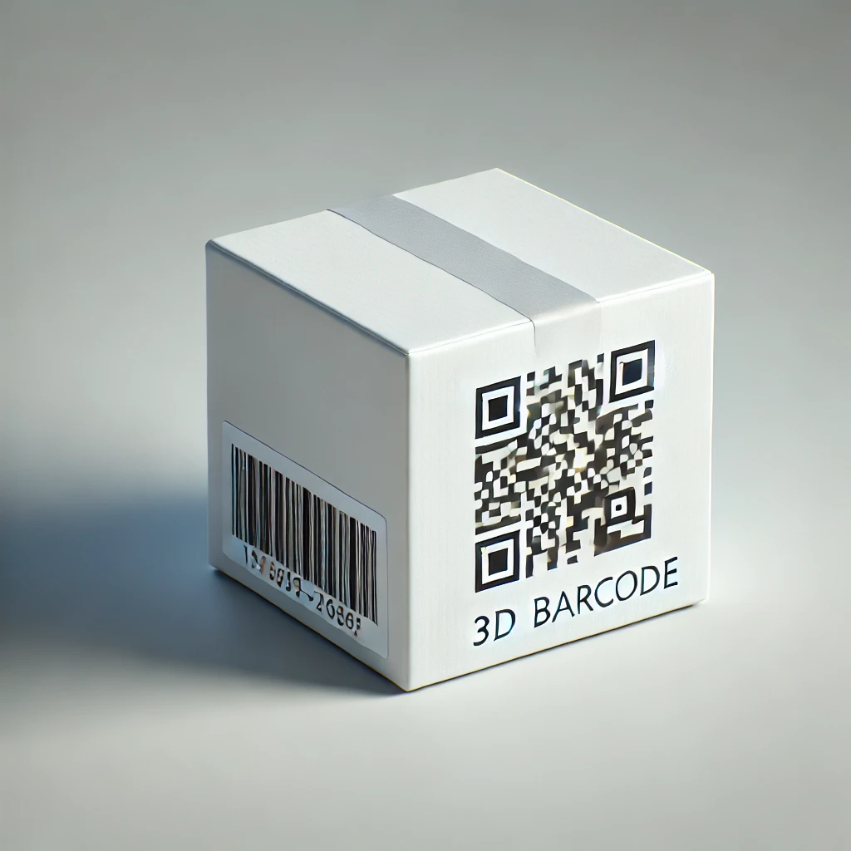

OTHER EXAMPLES FROM THE PHARMA INDUSTRY
21 Feb, 2025
Fake QR Codes on Branded Medicines...! Huge Scam Uncovered in Drug Supply Network.
Authorities raided a drug supply agency in Howrah's Amta and discovered counterfeit medicines with fake QR codes of branded pharmaceutical companies
More worrying for the consumers, the fake medicine manufacturer even copied the QR code, which actually differentiates the authentic medicines from the spurious ones.
Feb 22, 2025
India's drug QR code programme: anatomy of a debacle
Avi Chaudhuri, 12-Mar-2025

Slide 15
WHY PHYSICAL FEATURES MATTER IN THE DIGITAL AGE

Slide 16

SPOT THE COUNTERFEIT

Slide 17
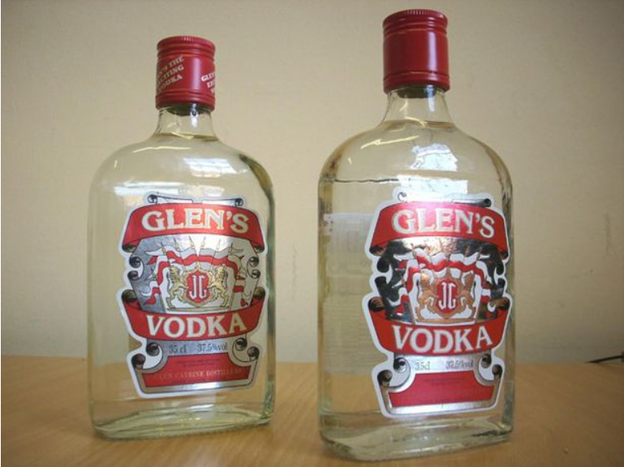
SPOT THE COUNTERFEIT

Slide 18
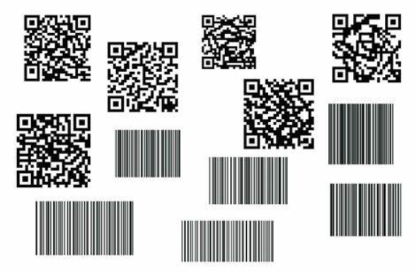
SPOT THE COUNTERFEIT

Slide 19


SPOT THE COUNTERFEIT

Slide 20
WHAT DO WE MEAN BY 'LAYERED SECURITY'?
Layered security describes the use of multiple secure (and non-secure) printing features and techniques used in combination to produce a product that combats counterfeiting, overproduction and smuggling.
IN SHORT... BANKNOTE GRADE SECURITY
Features are presented overtly, semi-covertly, and covertly
Nearly impossible to reproduce
Easy to identify (by public and enforcement)
Easy to monitor and control

Slide 21
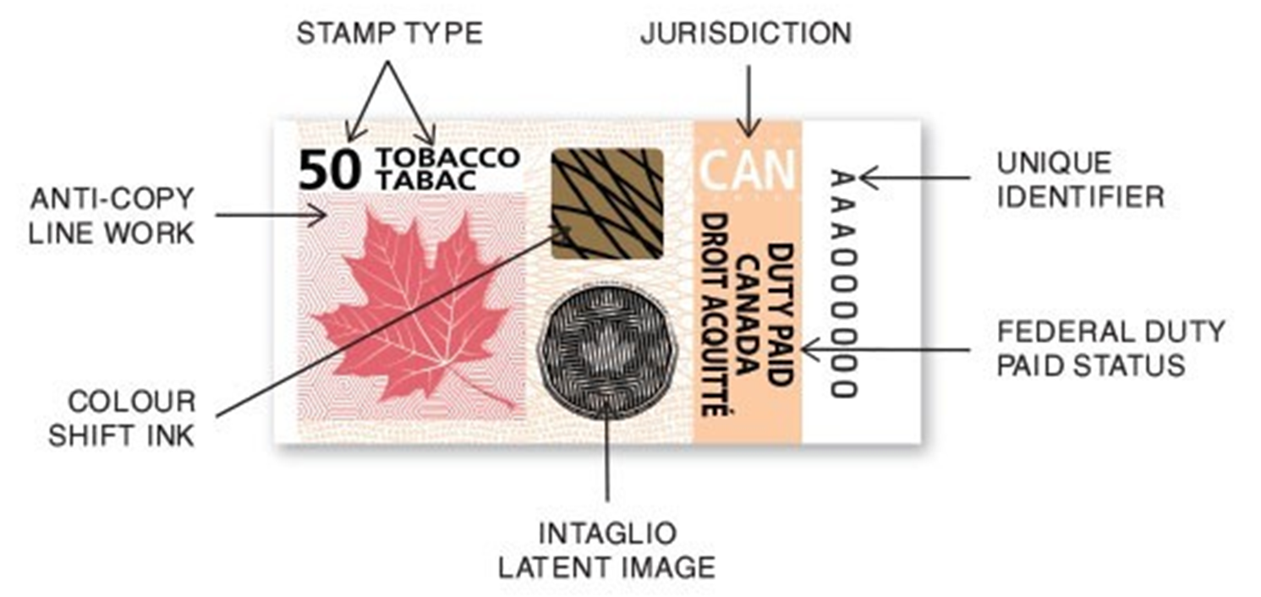
EXAMPLE OF OVERT LAYERED SECURITY

Slide 22
EXAMPLES OF SEMI COVERT AND COVERT LAYERED SECURITY
Invisible barcodes and markings
Deliberate errors
Specialised inks
UV reflective
IR transparent
Quantum and nano features

Slide 23


THE IMPORTANCE OF AN EDUCATED PUBLIC

Slide 24
USE CASE SUCCESS STORIES

Slide 25
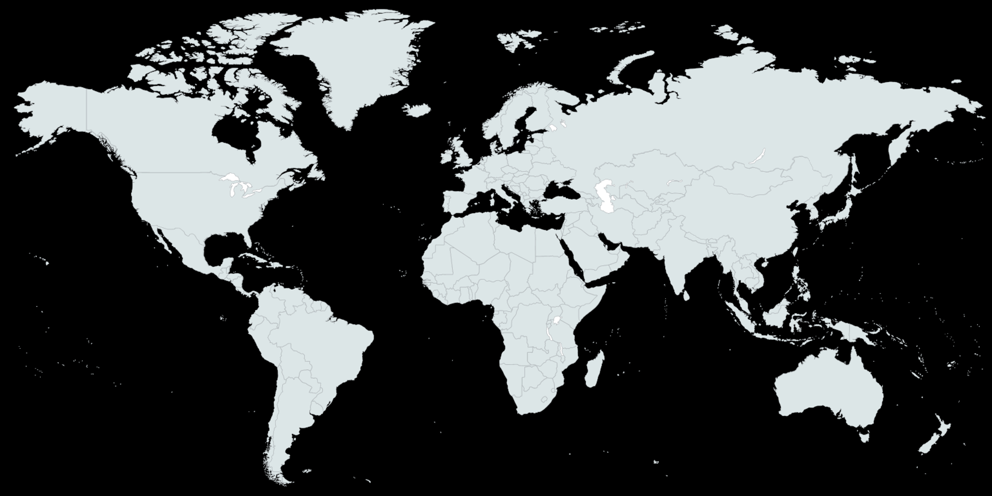
ENHANCED TAX STAMPS: SOME FIGURES
After first implementation of (“enhanced”) tax stamp
After moving from physical-only to *enhanced” tax stamp
MASSACHUSSETS
-70% Drop in seizures of illicit cigarettes in 2 years
CALIFORNIA
-37% Drop in tax evasion on cigarettes within two years
GAMBIA
+300% Increase in excise tax collection in 6 months (Tax Stamp & Traceability News)
DOMINICAN REPUBLIC
+72% Tax collection on spirits
+25% on tobacco
(El Dia)
KENYA
+45% Increase in excise tax collection
(WCO News)
UGANDA
+30% Increase in excise tax collection
(Monitor)
TANZANIA
31% Increase in excise tax collection
(The Citizen)
TANZANIA
+900% Increase in registered taxpayers since solution rollout

Slide 26
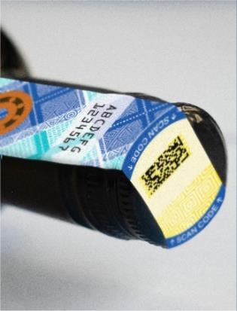
Moving from physical-only to Enhanced tax stamp: KENYA
Since 2003 Physical-only stamps for tobacco, wine, spirits
2013 Launch of Excisable Goods Management System (EGMS) – moving from physical-only to “enhanced tax stamp”: multilevel security, serialisation, remote automated monitoring on domestic lines, covering tobacco, wine, spirits, beer
2014 Rapid increase of excise revenue in 1 year: +45% (WCO News), largest for imported cigarettes +4728%
2016 upgrade to 2D barcode for smartphone authentication
2016-17 Further revenue increases achieved: spirits +22.7%, tobacco +13.3%
2019 Extension to bottled water, juice, soda, energy drinks – directly printed secure 2D barcode

Slide 27
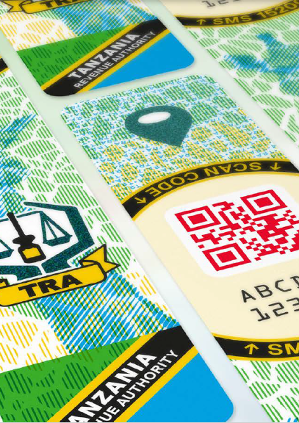
Moving from physical-only to Enhanced tax stamp: TANZANIA
1998-2018 TRA used a basic (authentication-only) tax stamp for tobacco, wines, spirits, CDs
2018 Launch of a new solution, with enhanced tax stamps, including traceability, production monitoring, for tobacco, alcohol & spirits, beer
2019 Extension to soft drinks
2021 Extension to Water, Juice, Multimedia
Registered manufacturers: +900%
Declared production: +300%
Registered importers: +250
Largest tax revenue increases: bottled water (+93%), locally-produced wines & spirits (+86.2%), Soft Drinks (+30%)

Slide 28

Implementing an Enhanced tax stamp from scratch: UGANDA
2019 Launch of an enhanced tax stamp program including traceability, production monitoring, for tobacco, alcohol & spirits, wines, beer, soda, bottled water
2021 Extension to cement and sugar
2022 Extension to kombucha, juice, fermented energy drinks and cooking oil
Registered taxpayers: 1’300 manufacturers and importers (300% increase)
Largest tax revenue increases: water +152%, soft drinks +89.1%, cement +55.3%, beer +48.3, spirits +44.4%
Enforcement results: more than 1,000 seizures, recovering UGX 20.98 billion (as of June 2024)

Slide 29
INFRASTRUCTURE AND SECURITY CONSIDERATIONS FOR BLENDED DIGITAL MARKING PROGRAMME

Slide 30





KEY DIGITAL V PHYSICAL CONSIDERATIONS
Security & technology
PROCESS & PRACTICALITY
LEGISLATION & ENFORCEMENT
INFRASTRUCTURE & management
Notes:
In the tax stamp world, there is not ‘one size fits all’
When considering the most suitable technology there are multiple areas to consider, that will differ depending on the products and geography of the program.
We’d just like to look at four areas to consider: Security and Technology, Process and Practicality, Legislation and Enforcement and Infrastructure and Management.

Slide 31

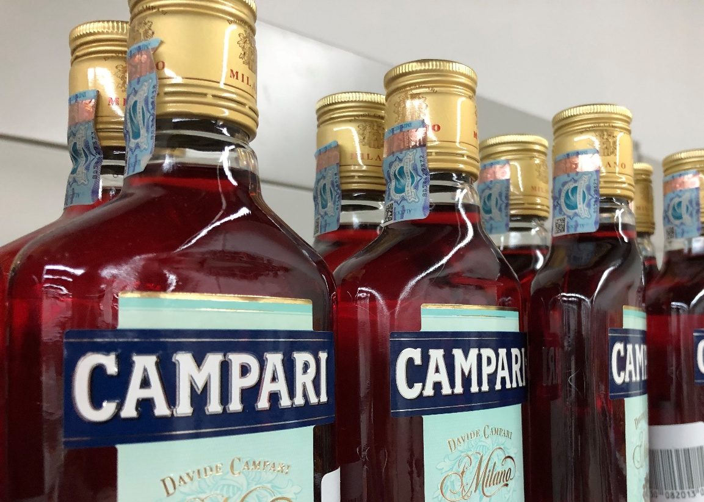
Security & technology: Risk Profile
Detailed auditing and risk profiling is vital to match trade challenges with suitable technology
Product Risk Profile
Regional Risk Profile
Product | Estimated Illicit Trade Level | Temp/Environment
Beer | <5% | Low value unit, but high volume
Wine | ~5% | Illicit trade typically targets high end
Spirits | <10 - >45% | Varies dramatically on region
Cigarettes | ~10 - 12% | Typical global estimate from WHO
Continent | Estimated Illicit Trade Level in Liquor Spirits*
Africa | Roughly 20–45% or higher in vulnerable markets
Europe | Approximately 8–10%; up to ~30% in certain border/high‐tax regions
South America | Around 20–30% (but significant variation among countries)
North America | Generally 5–10%, with localized spikes near borders
Asia | Highly variable – 5–10% in developed markets; 20–30% in emerging markets; overall ~15–25%
* various sources: iol.co.za, spirits.eu, thedrinksbusiness.com, oecd.org, eu-asean.eu, apiswa.org, tracit.org, sab.co.za

Slide 32
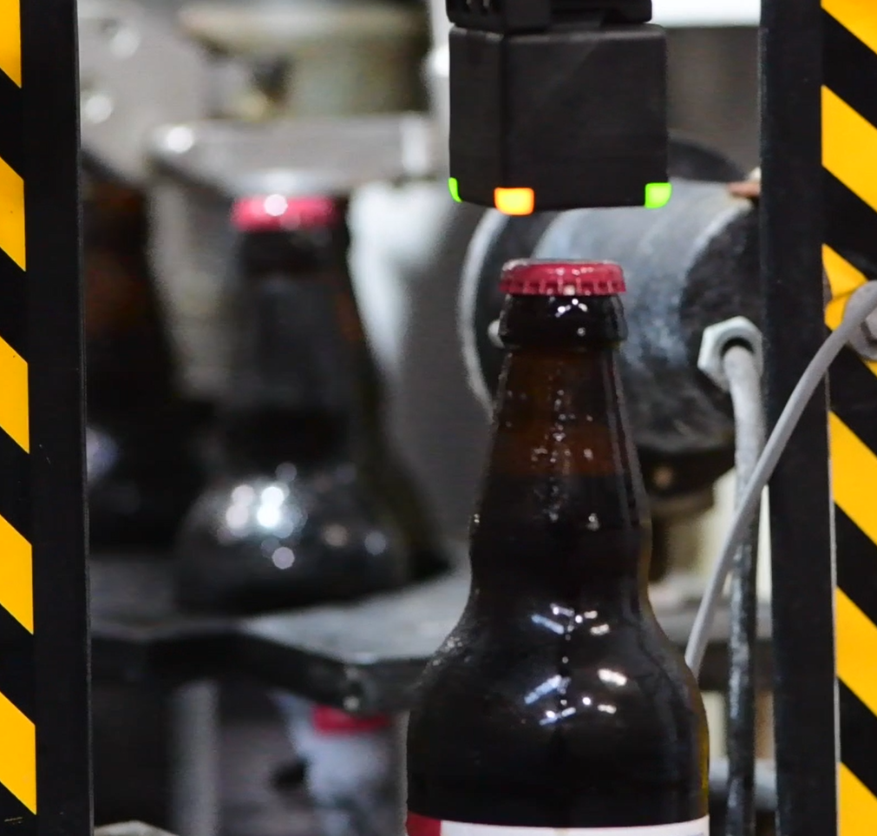
PROCESS & practicality
Risk profile needs to be compared against the specific manufacturing challenges
Product aggregation & cross-border data sharing add further complexities
Line Speeds & Environment
Product | Speed Range (BPH) | Typical Speed (BPH) | Temp/Environment
Beer | 5,000 – 100,000 | 12,000 – 60,000 | ~3ºC – Wet/Cold
Wine | 600 – 12,000 | 2,000 – 6,000 | ~12ºC – Cool
Spirits | 1,000 – 30,000 | 3,000 – 12,000 | ~21ºC – Ambient
Product | Speed Range (Packs PH) | Typical Speed (Packs PH) | Temp/Environment
Cigarette | 12,000 – 60,000 | 24,000 – 36,000 | ~21ºC – Ambient

Slide 33

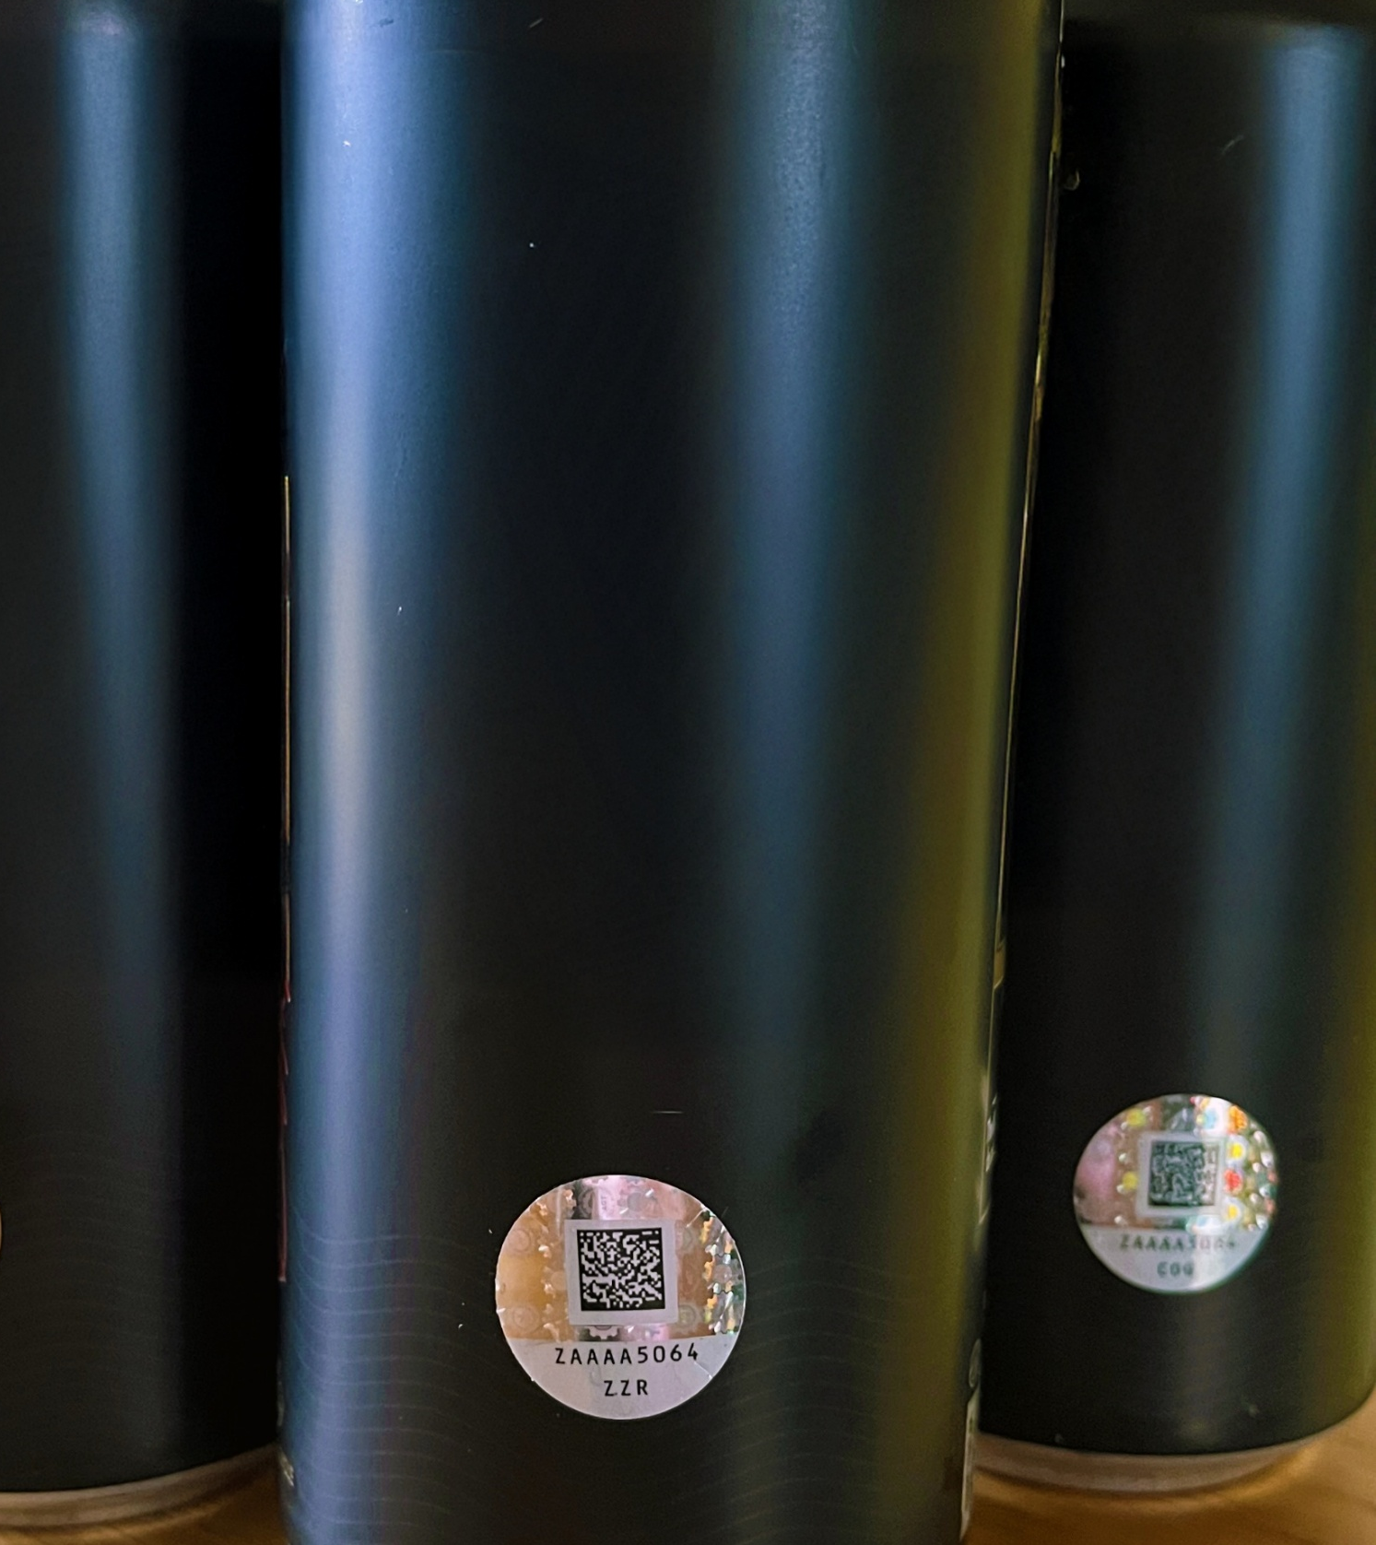







SELECTED KEY DIGITAL V PHYSICAL DECISION CONSIDERATIONS
For each sector to be marked, considerations include:
Anti-Tamper Capability
Low vs High Volume Options
Security Requirements
Scrap Management
Stamp Cost v Product Value
Stamp Adhesion

Slide 34
DIGITAL MARKING - SECURITY COMPONENT CONSIDERATIONS
CIJ Security Inks
INDEPENDENT SECURE UIDS
Track & Trace Integration
Production Monitoring
Physical (in person) Security
Authentication Tools

Slide 35

DIGITAL MARKING: Infrastructure & management
Key Considerations for Governments
Print Technology
Activation Equipment
Line Controllers
Consumables (inks etc.)
System Management
Infrastructure Maintenance
Factory Servers
Heavily capital investment
Heavy factory line management vs physical stamps
Ownership Options: government, solution provider, industry, multi-vendor
Consideration for competitive re-tender

Slide 36

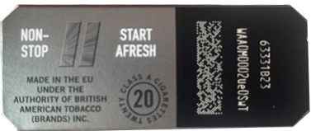

Legislative considerations
Planning for success
Enabling Enforcement
Without enforcement & punishment, neither physical or digital technology will be effective
Enforcing Program Use
Legislation must be clear and enforce use of technology by economic operators
Future Competition
Legislation should be detailed, but avoiding sole-supply technologies
Existing Frameworks – ITP / EU TPD
Some external frameworks may affect domestic requirements
WHO ITP / EU TPD, EU Pharmaceutical Directives, Digital Product Passport
Legislative Considerations – Republic of Malta
Physical Tax Stamp Upgraded by OpSec in 2019 to meet EU Legislation
EU TPD compliant codes required to meet legislation
Physical & digital codes both generated & authenticated within OpSec InSight® to brand level

Slide 37
KEY DIGITAL V PHYSICAL CONSIDERATIONS
Security & technology
PROCESS & PRACTICALITY
No two countries the same in terms of industry & illicit trade challenges
While digital physical stamps offer the greatest security, these may not be always be feasible
Early, effective industry auditing and risk profiling vital
INFRASTRUCTURE & management
LEGISLATION & ENFORCEMENT
Careful consideration of any digital marking infrastructure ownership vital
Consideration of full turnkey solution, government ownership or hybrid model
Legislation must be effective, enforcing industry participation and enabling enforcement

Slide 38
A DILIGENT APPROACH TO DIGITAL AND PHYSICAL LAYERED SECURITY

Slide 39
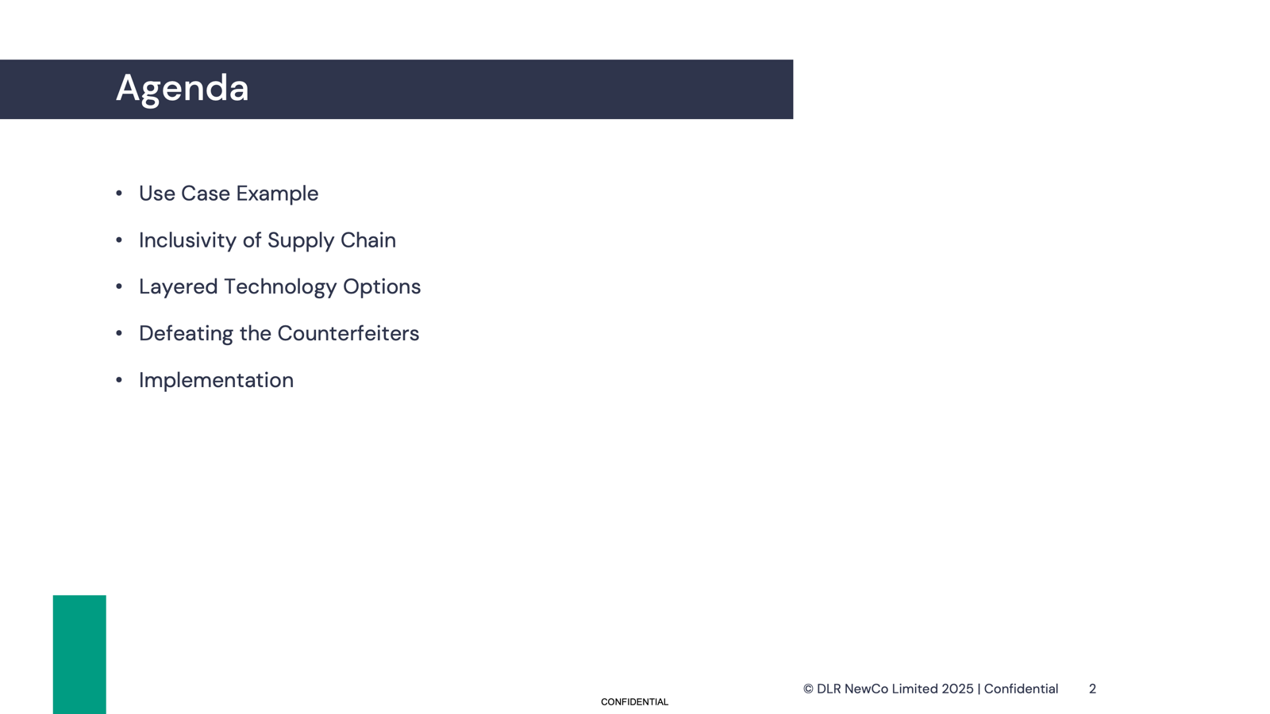

Slide 40
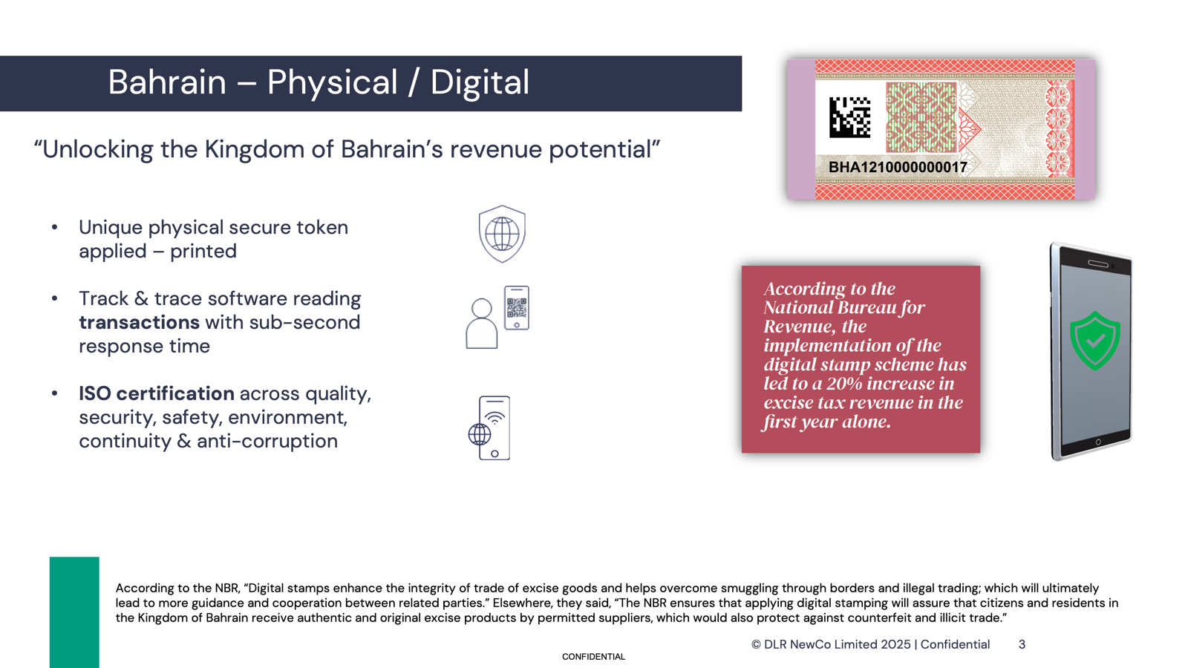

Slide 41
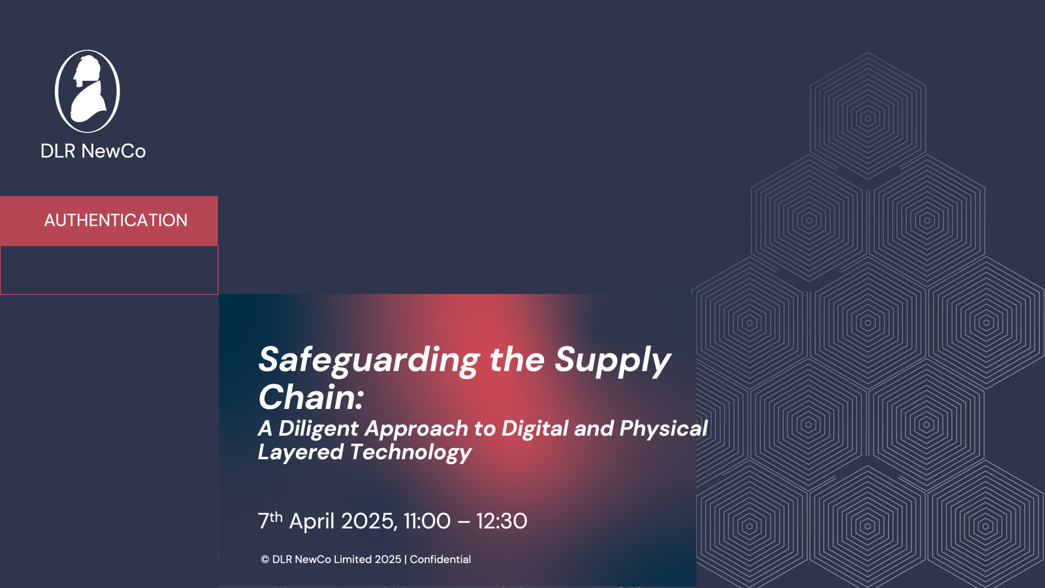
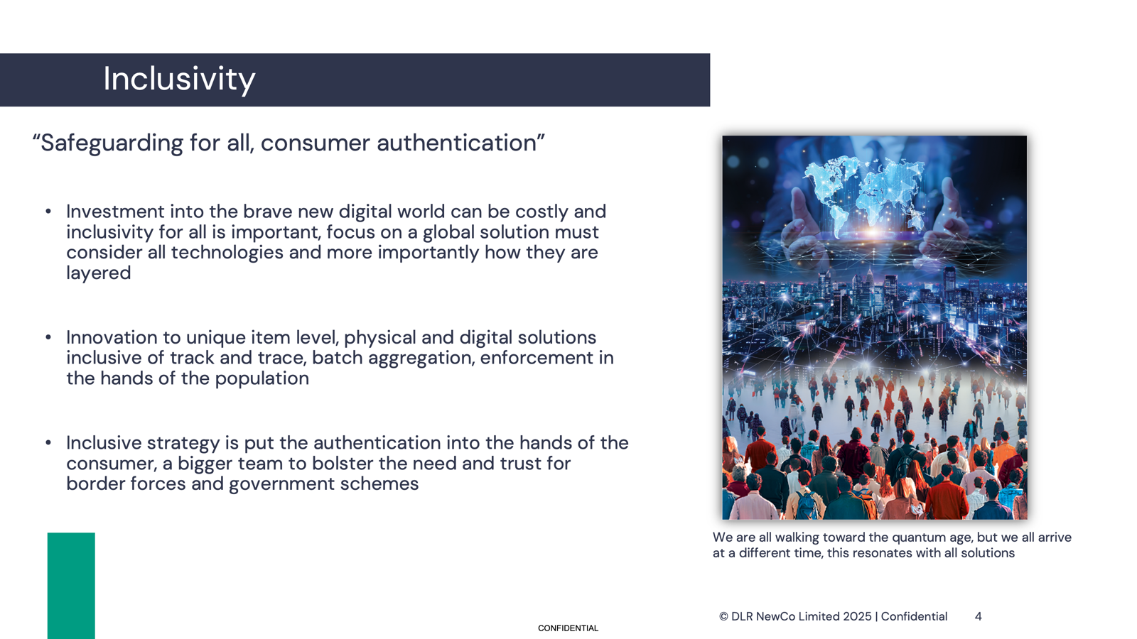
KEY INFRASTRUCTURE AND SECURITY CONSIDERATIONS FOR A BLENDED DIGITAL MARKING PROGRAMME

Slide 42

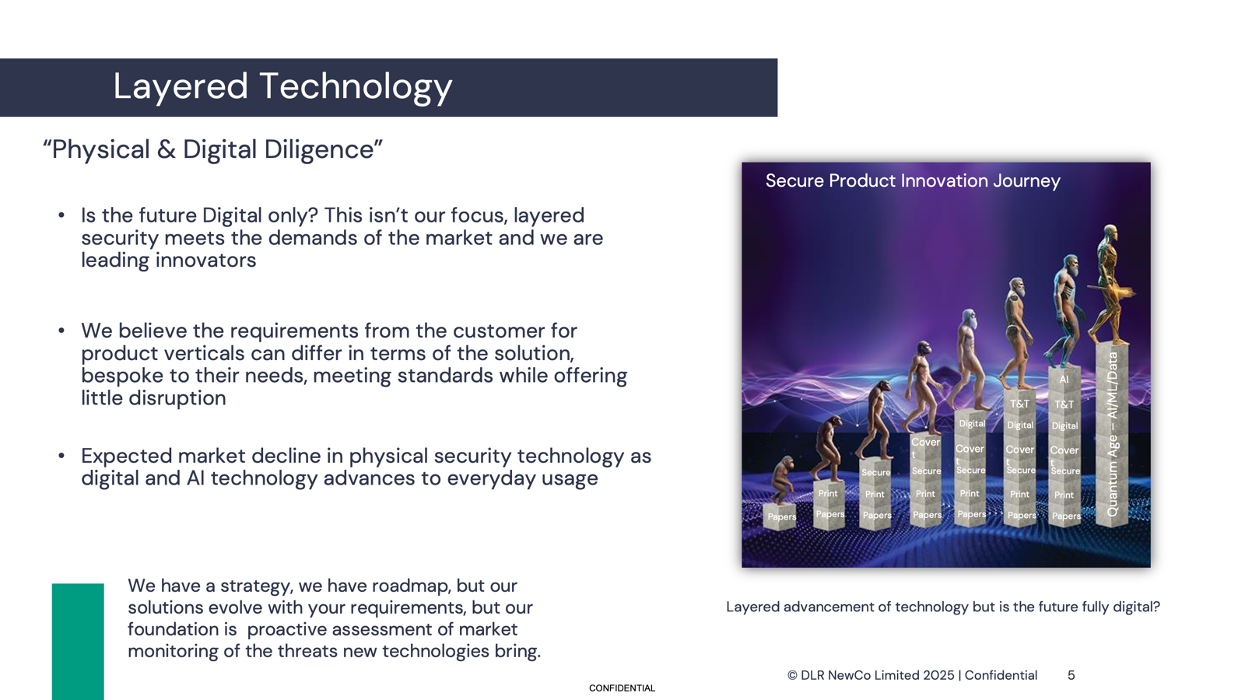

Slide 43
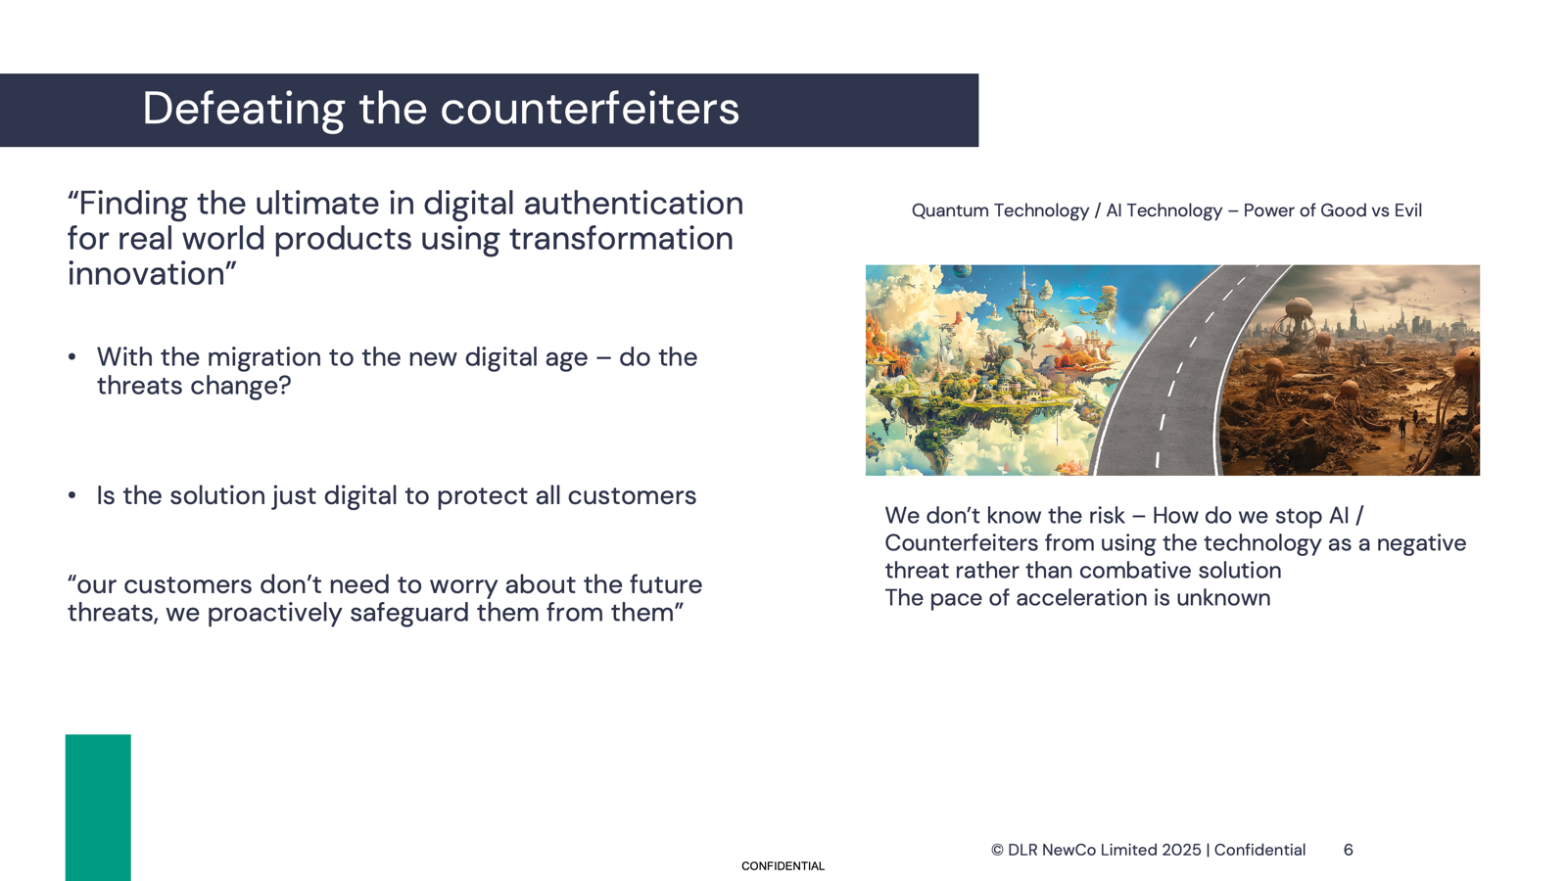

Slide 44
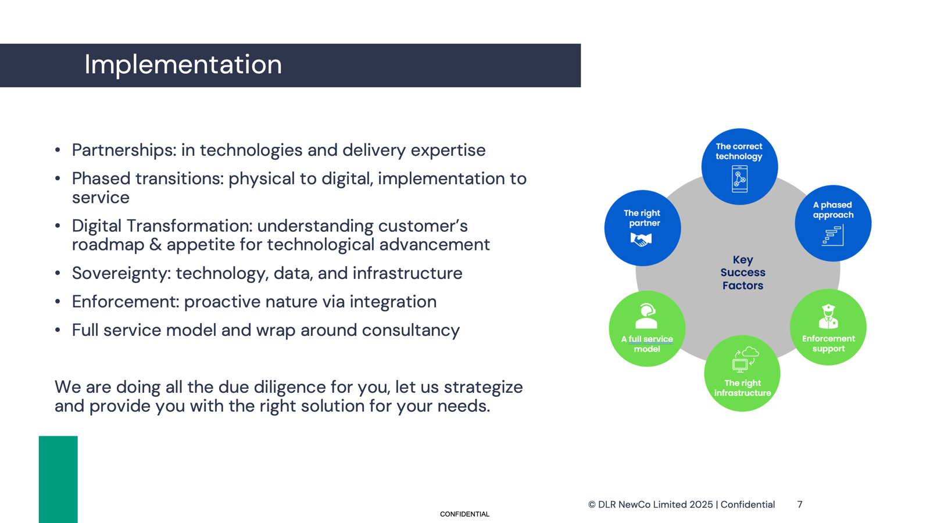

Slide 45
INNOVATION IN TAX STAMPS – PHYSICAL AND DIGITAL ASPECTS

Slide 46
Securikett pre-recorded presentation

Slide 47
DISCUSSION

Slide 48

QUESTIONS? REMARKS?

Slide 49
EXERCISE
What are the most important elements of a technology solution that determine the success of a tax stamp programme?

Slide 50
WHAT ARE THE MOST IMPORTANT ELEMENTS OF A TECHNOLOGY SOLUTION THAT DETERMINE THE SUCCESS OF A TAX STAMP PROGRAMME?
Independence from the controlled industry
Resistance of the security features against counterfeiting
Traceability at point of manufacture
Traceability in the distribution chain, down to retail
Online activation / Production monitoring
Enforcement team resources
Authentication and traceability for field inspections
Consumer verification / authentication using smartphone
Operational reporting
Advanced analytics
Integration with tax & customs management systems
Price
Other…

